Slide 1
Operation Analytics and Investigating Metric Spike
By:
Mihirsinh Rathod

Slide 2
DESCRIPTION
Operation Analytics is the analysis done for the complete end to end operations of a company. With the help of this, the company then finds the areas on which it must improve upon. You work closely with the ops team, support team, marketing team, etc and help them derive insights out of the data they collect.

Slide 3
APPROACH
In this project, we have analyzed duplicate records, the number of events that occurred in the company, the number of languages spoken there, and job reviews. Investigating metric spikes is a crucial component of operational analytics since a data analyst must be able to comprehend questions or help other teams do the same. Regarding engagement, development, weekly retention, email, etc., we have numerous inquiries.

Slide 4
TECH STACK USED
After carefully reading the instructions and considering the data that the team actually needed, I imported the data into SQL and ran a number of commands against it to gain a deeper understanding of it. From there, I learned the insights that the team would need to achieve their business, marketing, product, and development goals.
I used MySQL v8.0 on DB Fiddle (an online SQL editor, database playground for testing, debugging and sharing SQL snippets.
And mode.com ((Mode is a modern analytics and BI solution that combines SQL, Python, R and visual analysis to answer questions faster

Slide 5
Insights
To gain the insights, I used a variety of SQL commands, and working on this project educated me how to use realtime SQL. I learned more about the way SQL works as well. I understood the information given about operation analytics and looking at metric spike. I gleaned a number of insights from the platform's metrics, along with the number of jobs reviewed, the percentage share of each language, duplicate rows, user engagement, and weekly retention and engagement.

Slide 6
RESULTS
From the provided data, I extracted a number of data, the specifics of which are described below, allowing me to pick up real-time SQL commands.
Case Study 1 (Job Data)
A :
Number of jobs reviewed: Amount of jobs reviewed over time. task: Calculate the number of jobs reviewed per hour per day for November 2020?
SELECT
COUNT(DISTINCT job_id)/(30*24)
FROM job_data WHERE
ds BETWEEN ‘2020-11-01’ AND ‘2020-11-30’

Slide 7
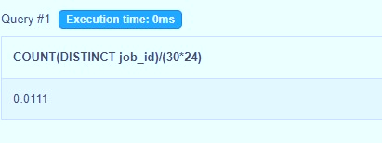

Slide 8
B: Throughput: It is the no. of events happening per second. task: Let’s say the above metric is called throughput. Calculate 7 day rolling average of throughput? For throughput, do you prefer daily metric or 7-day rolling and why?
SELECT ds, event_per_day,
AVG(event_per_day)OVER(ORDER BY ds ROWS BETWEEN 6 PRECEDING AND
CURRENT ROW)AS 7_day_rolling_avg FROM
(SELECT ds, COUNT(DISTINCT event) AS event_per_day
FROM job_data WHERE
ds BETWEEN ‘2020-11-01’ AND ‘2020-11-30’
GROUP BY ds
ORDER BY ds)a

Slide 9
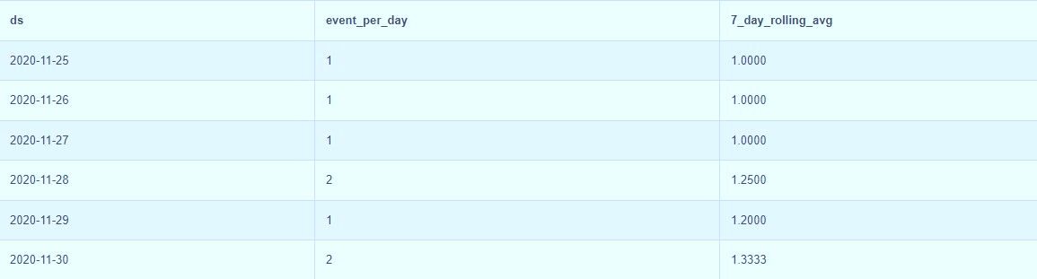

Slide 10
C: Percentage share of each language: Share of each language for different contents. task: Calculate the percentage share of each language in the last 30 days?
SELECT language, 100.0* num_jobs/total_jobs AS pct_share
FROM
(
SELECT language, COUNT(DISTINCT job_id) AS num_jobs
FROM job_data
GROUP BY
Language)a
CROSS JOIN
(
SELECT COUNT(DISTINCT job_id) AS total_jobs
FROM job_data)b
ORDER BY pact_share DESC

Slide 11
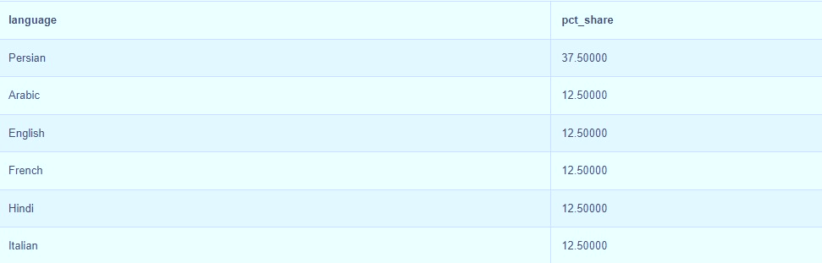

Slide 12
D: Duplicate rows: Rows that have the same value present in them. task: Let’s say you see some duplicate rows in the data. How will you display duplicates from the table?
SELECT *
FROM
( SELECT *,
ROW_NUMBER()OVER(PARTITION BY job_id) AS rownum
FROM job_data
)a
WHERE rownum > 1

Slide 14
Case study 2
Investigating metric spike

Slide 15
A:User Engagement: To measure the activeness of a user. Measuring if the user finds quality in a product/service. task: Calculate the weekly user engagement?
select
extract(week from occurred_at)as week_num,
COUNT (distinct user_id)
FROM
tutorial.yammer_events
GROUP by
week_num

Slide 16
week_num | count
18 | 791
19 | 1244
20 | 1270
21 | 1341
22 | 1293
23 | 1366
24 | 1434
25 | 1462
26 | 1443
27 | 1477
28 | 1556
29 | 1556
30 | 1593
31 | 1685
32 | 1483
33 | 1438
34 | 1412
35 | 1442

Slide 17
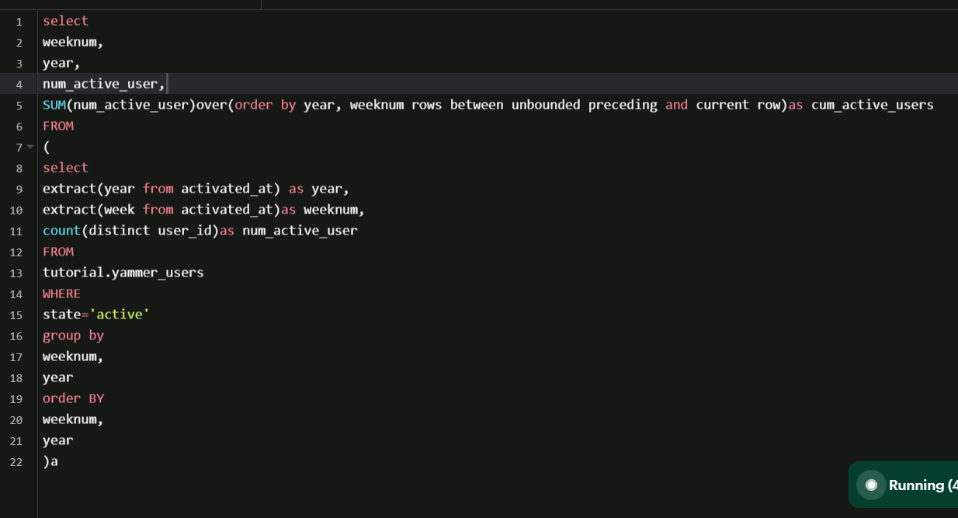
B: User Growth: Amount of users growing over time for a product. Your task: Calculate the user growth for product?

Slide 18
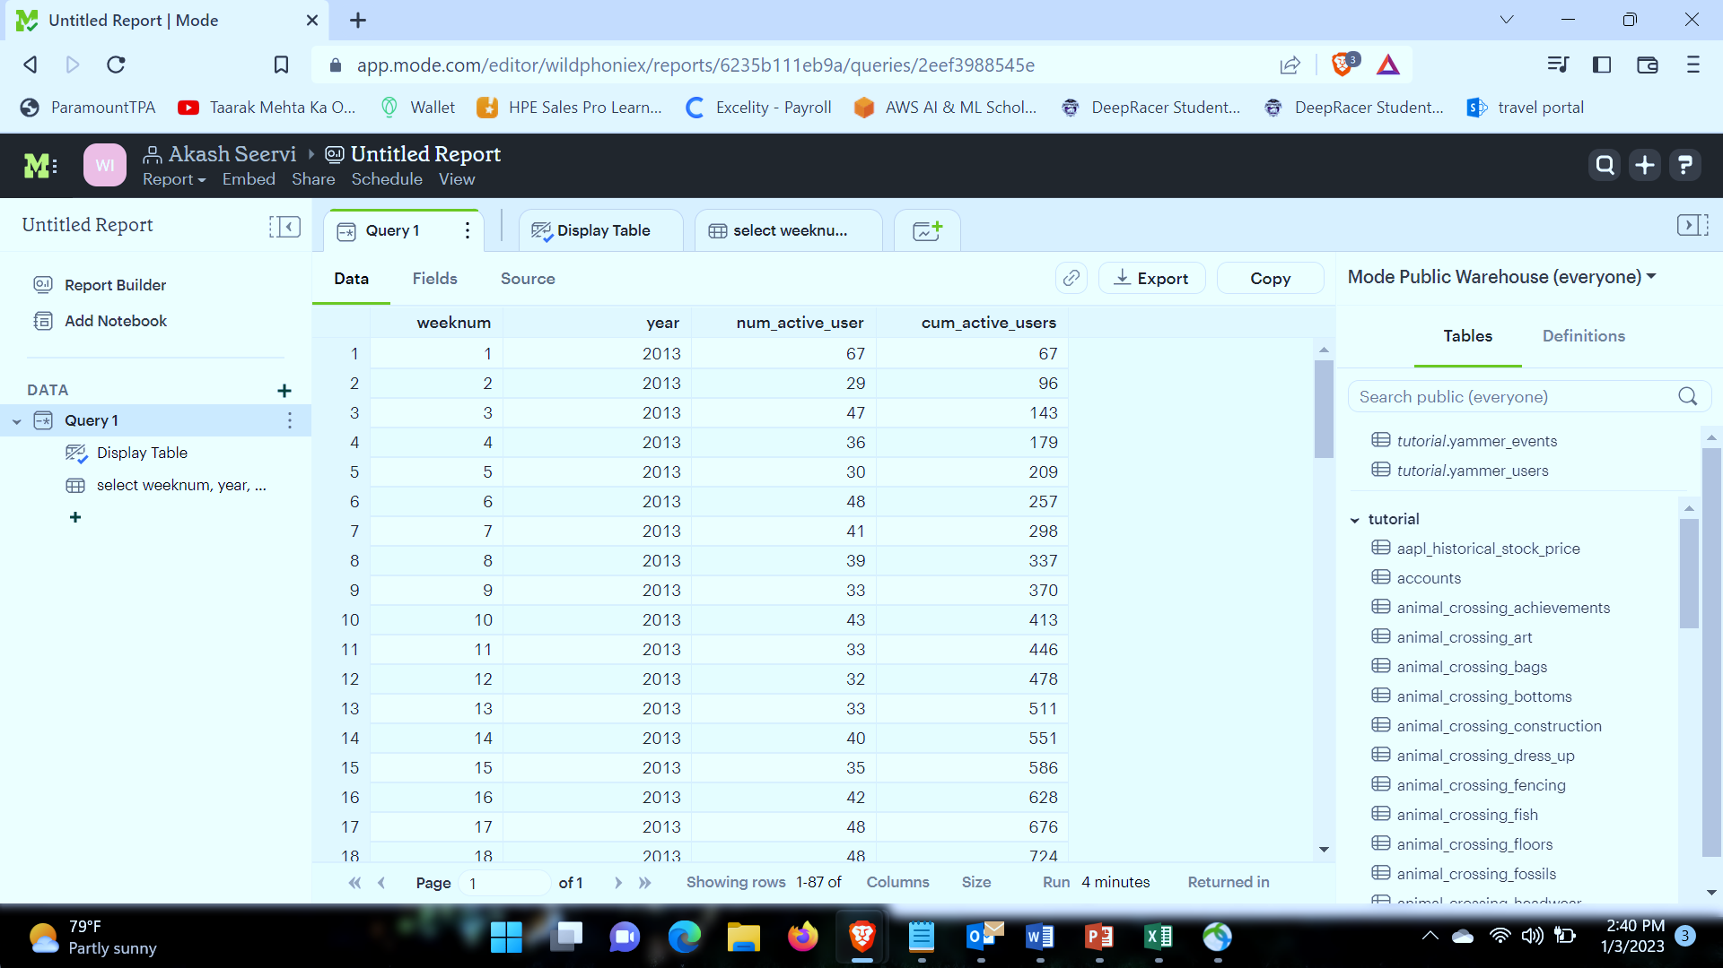

Slide 19
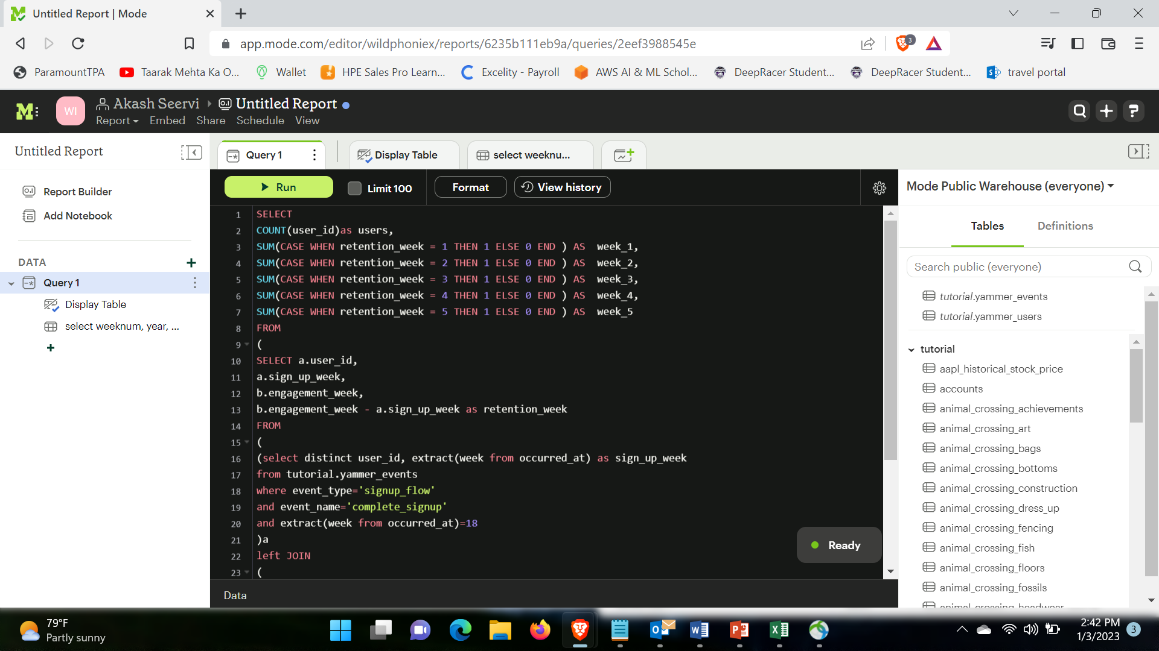
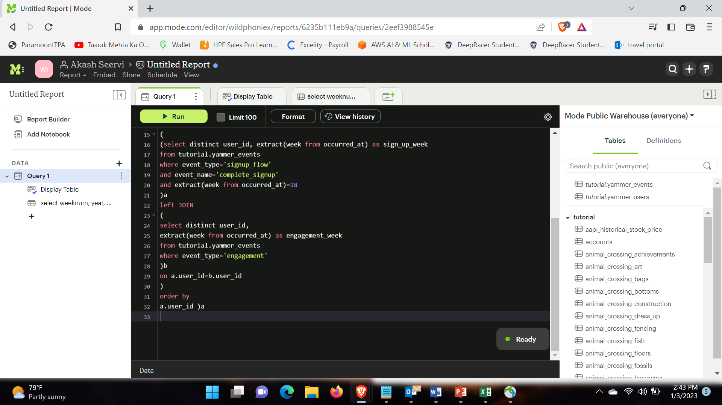
C:Weekly Retention: Users getting retained weekly after signing-up for a product. Your task: Calculate the weekly retention of users-sign up cohort?

Slide 20
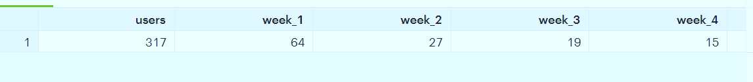

Slide 21
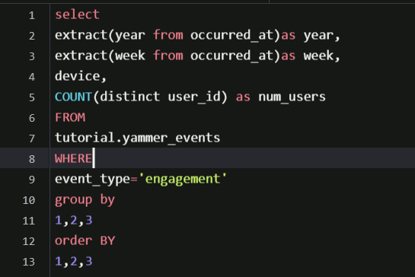
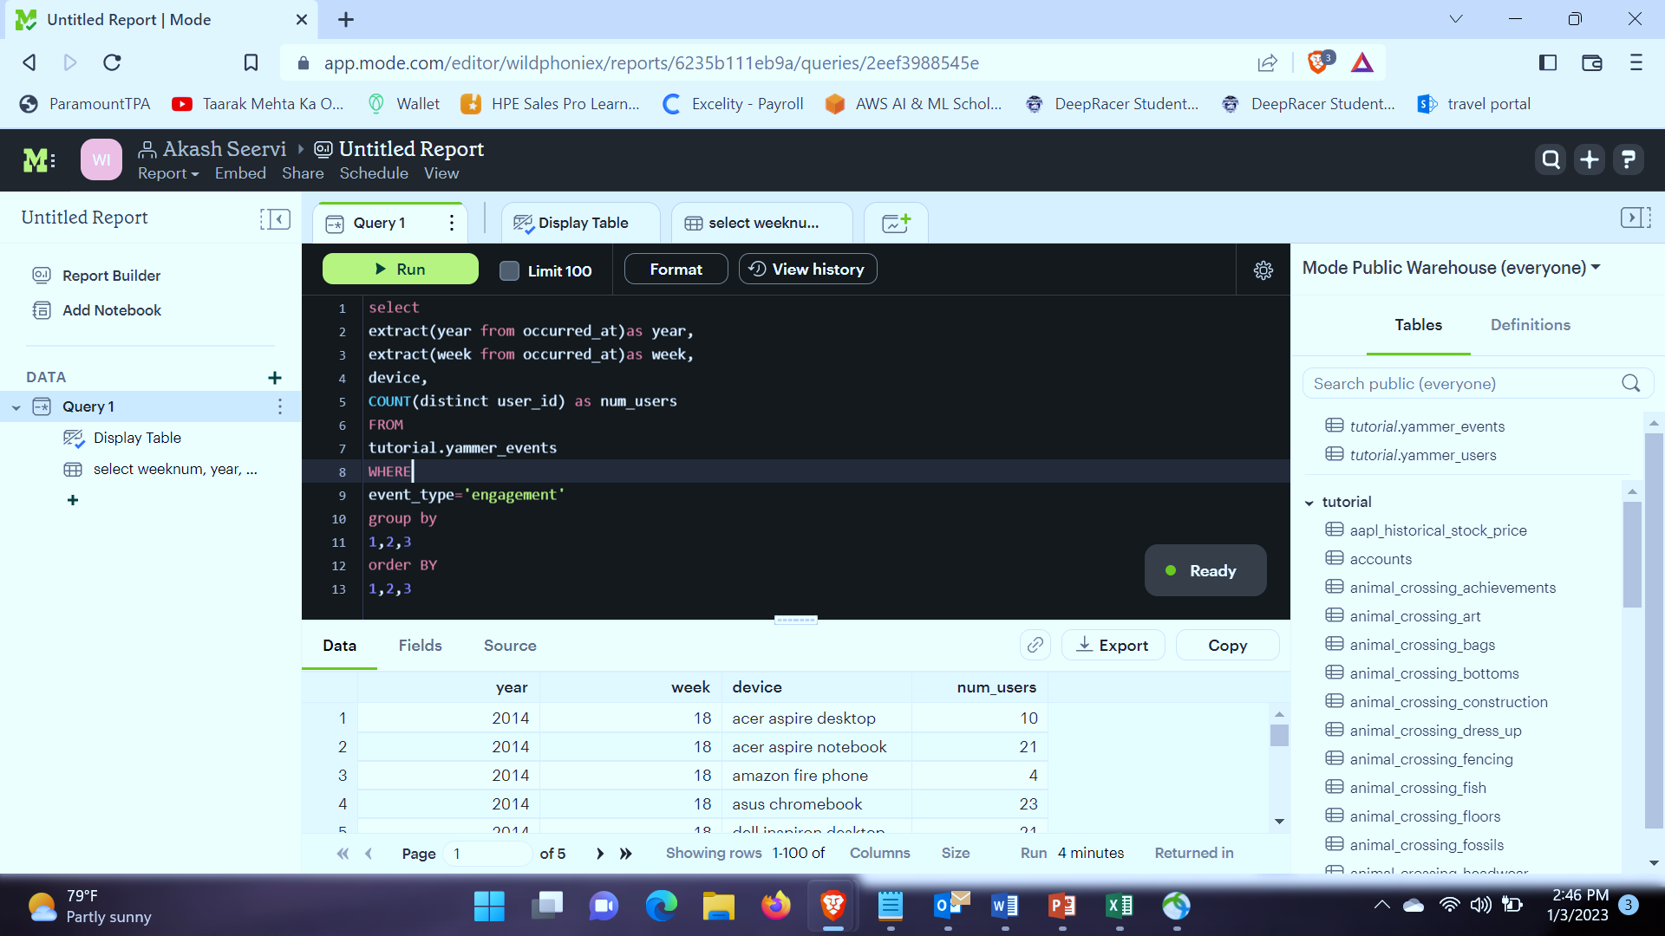
D: Weekly Engagement: To measure the activeness of a user. Measuring if the user finds quality in a product/service weekly. Your task: Calculate the weekly engagement per device?

Slide 22
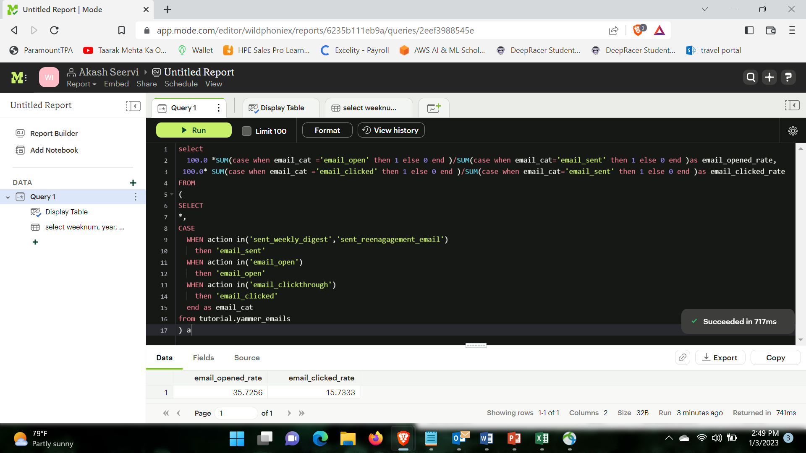
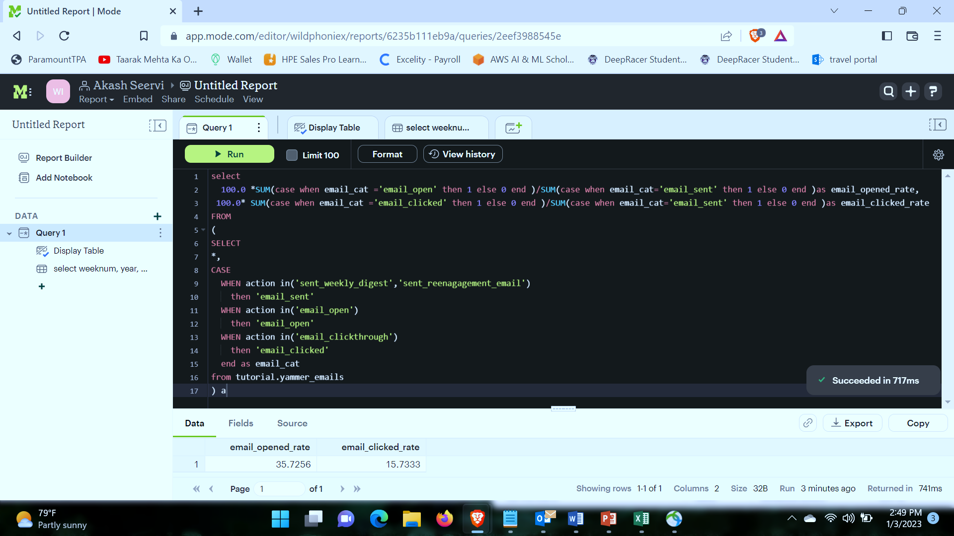
E: Email Engagement: Users engaging with the email service. Your task: Calculate the email engagement metrics?

Slide 23
THANK YOU

